Slide 1
When simulation is the appropriate tool
Simulation enable the study of internal interaction of a subsystem with complex system
Informational, organizational and environmental changes can be simulated and find their effects
A simulation model help us to gain knowledge about improvement of system
Finding important input parameters with changing simulation inputs
Simulation can be used with new design and policies before implementation

Slide 2
When Simulation is not Appropriate
When the problem can be solved by common sense.
When the problem can be solved analytically.
If it is easier to perform direct experiments.
If cost exceed savings.
If resource or time are not available.
If system behavior is too complex.
Like human behavior

Slide 3
Phases of Simulation study
Phase I: Problem Formulation
Phase II: Model Building
Phase III: Running the Model
Phase IV: Implementation

Slide 4
Steps involved in developing a simulation model
Step 1. Identify the problem:
Enumerate problems with an existing system. Produce requirements for a proposed system
Step 2. Formulate the problem:
Select the bounds of the system, the problem or a part thereof, to be studied.
Define overall objective of the study and a few specific issues to be addressed.
Define performance measures - quantitative criteria on the basis of which different system configurations will be compared and ranked.
Identify, briefly at this stage, the configurations of interest and formulate hypotheses about system performance.
Decide the time frame of the study, i.e., will the model be used for a one-time decision (e.g., capital expenditure) or over a period of time on a regular basis (e.g., air traffic scheduling).
Identify the end user of the simulation model, e.g., corporate management versus a production supervisor.
Problems must be formulated as precisely as possible.
Step 3. Collect and process real system data
Collect data on system specifications (e.g., bandwidth for a communication network), input variables, as well as Altered System
Study Simulation Experiment Simulation Analysis Conclusions performance of the existing system.
Identify sources of randomness in the system, i.e., the stochastic input variables. Select an appropriate input probability distribution for each stochastic input variable and estimate corresponding parameter(s).
Software packages for distribution fitting and selection include Expert Fit, Best Fit, and add-ons in some standard statistical packages.

Slide 5
Step 4. Formulate and develop a model:
Develop schematics and network diagrams of the system (How do entities flow through the system?).
Translate these conceptual models to simulation software acceptable form.
Verify that the simulation model executes as intended. Verification techniques include traces, varying input parameters over their acceptable range and checking the output, substituting constants for random variables and manually checking results, and animation.
Step 5. Validate the model:
Compare the model's performance under known conditions with the performance of the real system.
Perform statistical inference tests and get the model examined by system experts.
Assess the confidence that the end user places on the model and address problems if any.
Step 6. Document model for future use
Variables of a simulation model so that we may observe and identify the reasons for changes in the performance measures.
The number of experiments in a simulation study is greater than or equal to the number of questions being asked about the model (e.g., Is there a significant difference between the mean delay in communication networks A and B?, Which network has the least delay: A, B, or C? How will a new routing algorithm affect the performance of network B?).
Design of a simulation experiment involves answering the question: what data need to be obtained, in what form, and how much? The following steps illustrate the process of designing a simulation experiment.
Step 7. Select appropriate experimental design
Select a performance measure, a few input variables that are likely to influence it, and the levels of each input variable.
When the number of possible configurations (product of the number of input variables and the levels of each input variable) is large and the simulation model is complex, common second-order design classes including central composite, Box-Behnken, and full factorial should be considered.
Document the experimental design.
Step 8. Establish experimental conditions for runs:
Address the question of obtaining accurate information and the most information from each run.
Determine if the system is stationary (performance measure does not change over time) or non-stationary (performance measure changes over time).
Select the run length. Select appropriate starting conditions (e.g., empty and idle, five customers in queue at time 0).
Select the length of the warm-up period, if required.
Decide the number of independent runs - each run uses a different random number stream and the same starting conditions - by considering output data sample size.

Slide 6
Step 9. Perform simulation runs
Perform runs according to steps 7-8 above Most simulation packages provide run statistics (mean, standard deviation, minimum value, maximum value) on the performance measures, e.g., wait time (non-time persistent statistic), inventory on hand (time persistent statistic).
Step 10. Interpret and present results:
Compute numerical estimates (e.g., mean, confidence intervals) of the desired performance measure for each configuration of interest.
To obtain confidence intervals for the mean of auto correlated data, the technique of batch means can be used.
In batch means, original contiguous data set from a run is replaced with a smaller data set containing the means of contiguous batches of original observations. The assumption that batch means are independent may not always be true; increasing total sample size and increasing the batch length may help.
Step 11. Recommend further course of action:
This may include further experiments to increase the precision and reduce the bias of estimators, to perform sensitivity analyses, etc.

Slide 7
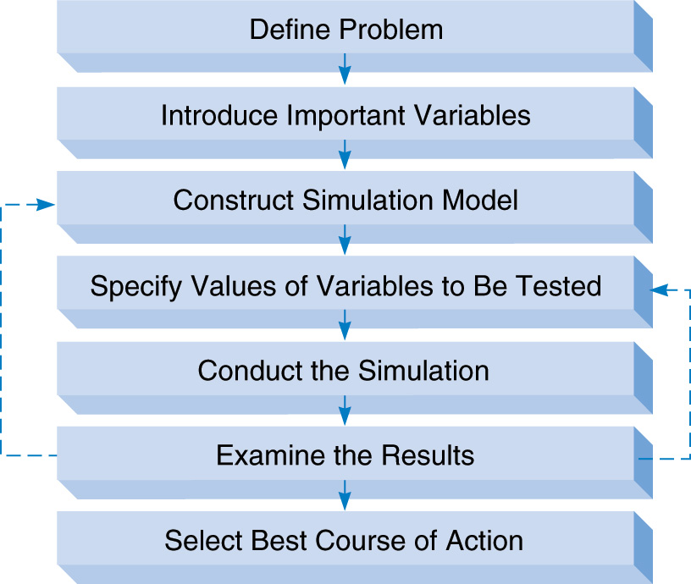
The Process of Simulation

Slide 8
Advantage of Simulation
Flexibility: Relatively straightforward and flexible
Can handle large and complex systems
Can be used to analyze large and complex real-world situations that cannot be solved by conventional models
Can answer “what-if” questions
Does not interfere with the real system
Allows study of interaction among variables
“Time compression” is possible
Handles complications that other methods can’t
Can study the interactive effects of individual components or variables in order to determine which ones are important

Slide 9
Disadvantages of Simulation
Can be expensive and may take months to develop
Does not generate optimal solutions: It is a trial-and-error approach that may produce different solutions in repeated runs
Managers must choose solutions they want to try (“what-if” scenarios)
Each model is unique

Slide 10
Application of Simulation
Computer Systems: hardware components, software systems, networks, data base management, information processing, etc..
Manufacturing: material handling systems, assembly lines, automated production facilities, inventory control systems, plant layout, etc.
Business: stock and commodity analysis, pricing policies, marketing strategies, cash flow analysis, forecasting, etc..
Government: military weapons and their use, military tactics, population forecasting, land use, health care delivery, fire protection, criminal justice, traffic control, etc.

